Slide 1
Home Automation with Alexa

Slide 2
Apopei Cristina Andreea – Technical Lead Coman Ruxandra Maria – Researcher Stanescu Denisa - Team Lead

Slide 3
OUR APP
We planned to create a Home Automation with Alexa project, that turns multiple lights on and off
As an extra feature we made possible synchronizing the lights with the phone through Bluetooth
Technologies: Arduino, ESP32, Alexa, Android Bluetooth Controller App
Purpose: smart home environment

Slide 4
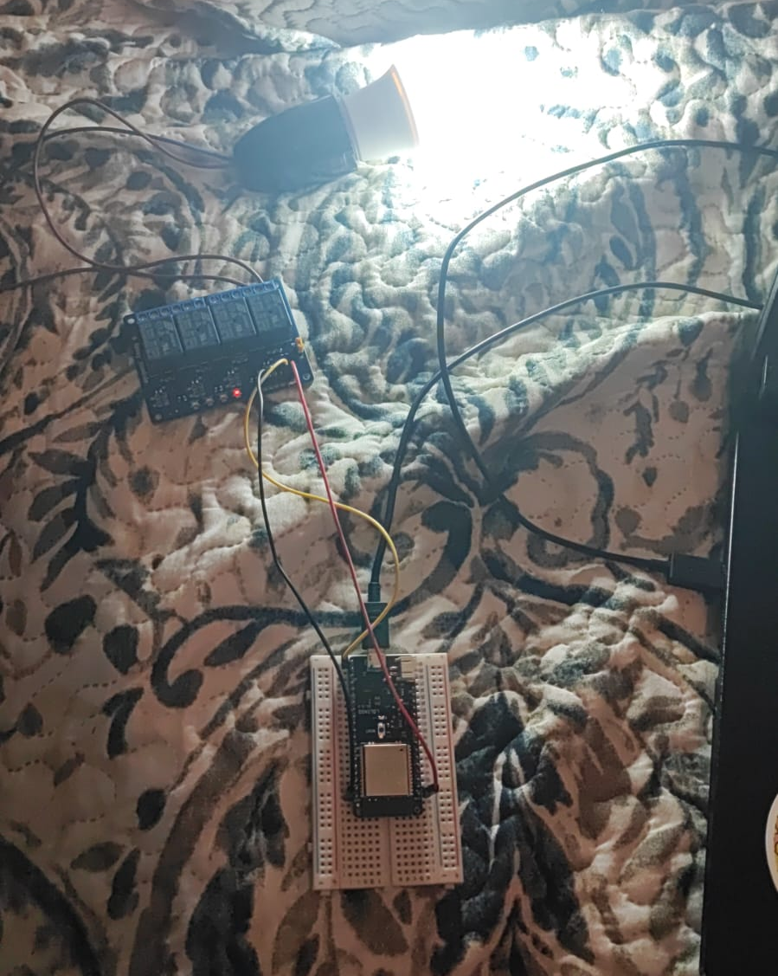
Development stages
I - Initial Stage – one lightbulb
In the initial stage, we chose to build the circuit with only one lightbulb to test if connectivity works.
We had to cut and solder the components and cables by using a soldering gun.
For initial connectivity, we used Arduino Bluetooth controller App from Play store.
The esp32 was only connected through bluetooth. After that, we installed the Arduino Skill on Alexa Store, and added the “Bedroom Lightbulb” to the Alexa App.

Slide 5
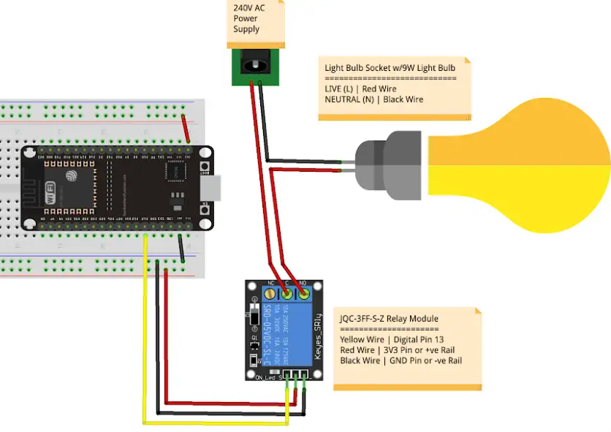
Initial stage schema

Slide 6
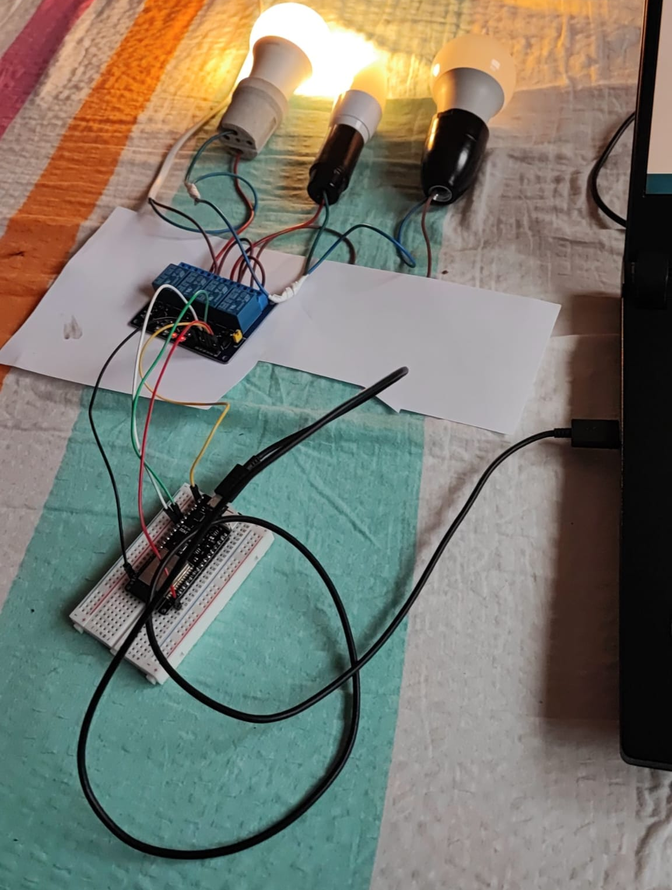
Development stages
II - Three Light Bulbs Stage
In the second stage, we chose to add two more lightbulbs for a more “Smart” home connectivity, each bulb representing a room in a home.
We had to cut and solder again the components and cables by using a soldering gun.
Besides the “Bedroom Lightbulb” on Alexa’s list, we also added a “Kitchen Light” and a “Bathroom Light”.
Only minor changes were necessary for the code.

Slide 7
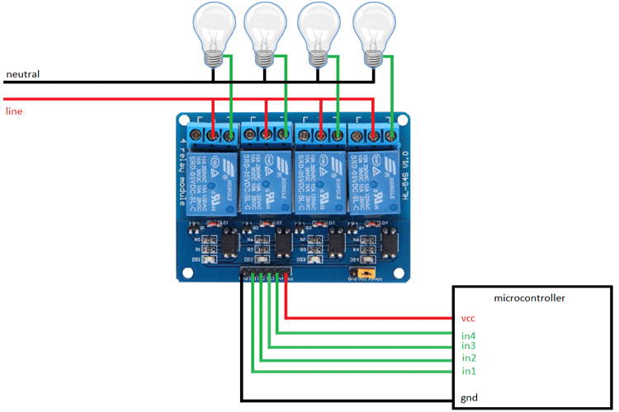
Second stage - added more lightbulbs – electrical schema

Slide 8
Code
#include <WiFi.h>
#include <BluetoothSerial.h>
#include <Espalexa.h>
const char* ssid = "Xiaomi 11T Pro";
const char* password = "xiaomiiinet";
BluetoothSerial SerialBT;
const int bedroomLightBulb = 15;
const int bathroomLightBulb = 16;
const int kitchenLightBulb = 17;
Espalexa espalexa;
void setBedroomLight(uint8_t brightness) {
digitalWrite(bedroomLightBulb, brightness > 0 ? HIGH : LOW);
}
void setBathroomLight(uint8_t brightness) {
digitalWrite(bathroomLightBulb, brightness > 0 ? HIGH : LOW);
}
void setKitchenLight(uint8_t brightness) {
digitalWrite(kitchenLightBulb, brightness > 0 ? HIGH : LOW);
}

Slide 9
Code
void connectToWiFi() {
WiFi.begin(ssid, password);
unsigned long startAttemptTime = millis(); // Attempt to connect for 10 seconds
while (WiFi.status() != WL_CONNECTED && millis() - startAttemptTime < 10000) {
delay(100);
}
} void setup() {
Serial.begin(9600);
SerialBT.begin("Bluetooth Lightbulb System");
pinMode(bedroomLightBulb, OUTPUT);
digitalWrite(bedroomLightBulb, LOW); // Ensure the lightbulb is OFF at the beginning
pinMode(bathroomLightBulb, OUTPUT);
digitalWrite(bathroomLightBulb, LOW);
pinMode(kitchenLightBulb, OUTPUT);
digitalWrite(kitchenLightBulb, LOW);
// Connect to Wi-Fi
connectToWiFi();

Slide 10
Code
// Initialize Espalexa
espalexa.addDevice("Bedroom Light", setBedroomLight);
espalexa.addDevice("Bathroom Light", setBathroomLight);
espalexa.addDevice("Kitchen Light", setKitchenLight); espalexa.begin();
} void loop() {
if (SerialBT.available()) {
int x = SerialBT.read();
if (x == '0') {
digitalWrite(bedroomLightBulb, LOW);
} else if (x == '1') {
digitalWrite(bedroomLightBulb, HIGH);
} else if (x == '2') {
digitalWrite(bathroomLightBulb, LOW);
} else if (x == '3') {
digitalWrite(bathroomLightBulb, HIGH);
} else if (x == '4') {
digitalWrite(kitchenLightBulb, LOW);
} else if (x == '5') {
digitalWrite(kitchenLightBulb, HIGH);
} }
espalexa.loop();
}

Slide 11
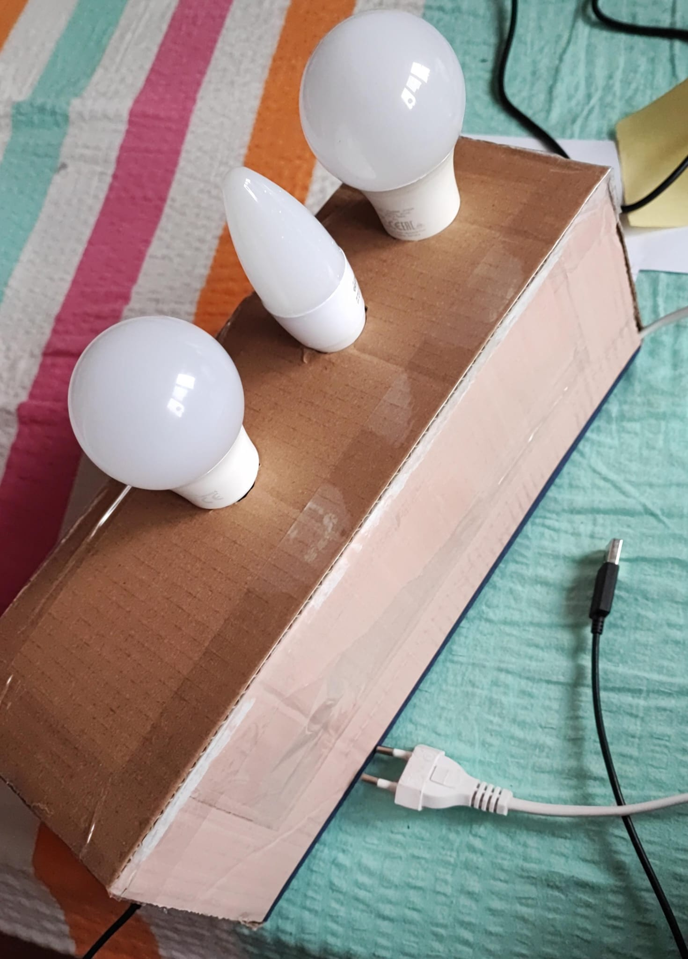
Development stages
III – Cosmetic stage
In the third stage, the technical project is finished, and we just had to work on making it aesthetically pleasing.
We wrapped all the contents in a box in order to protect the cables and the circuit components from damage or tearing.

Slide 12
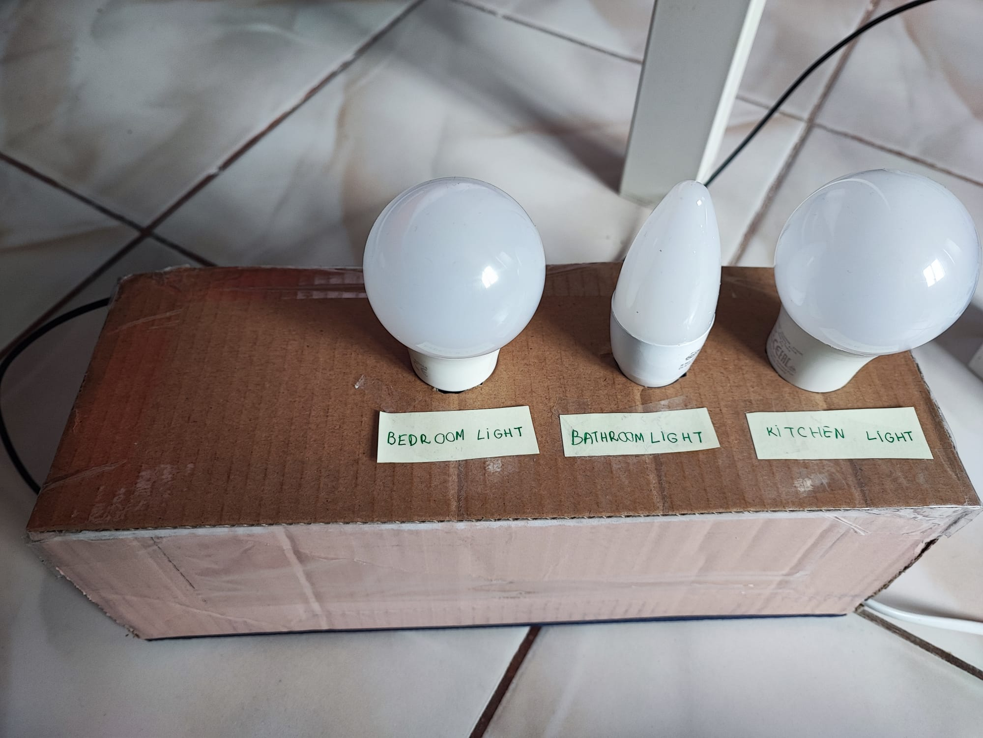
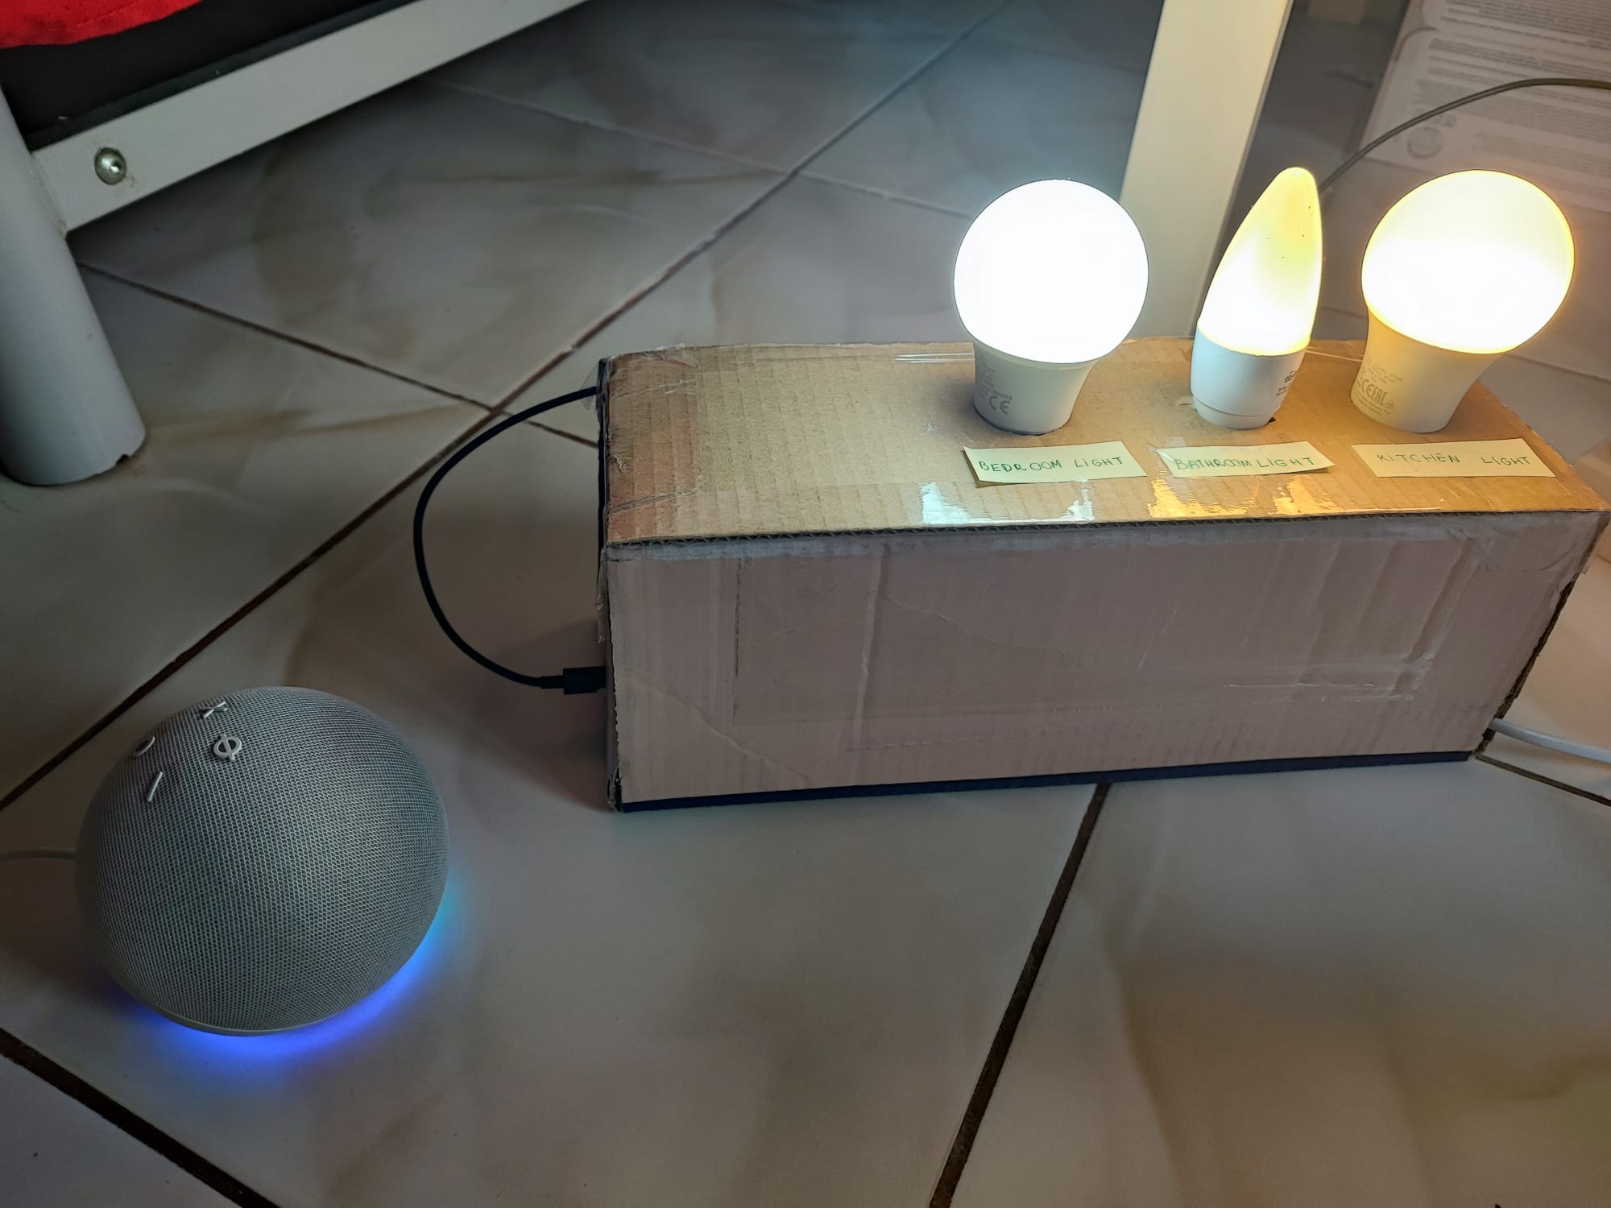
FINISHED PRODUCT

Slide 13
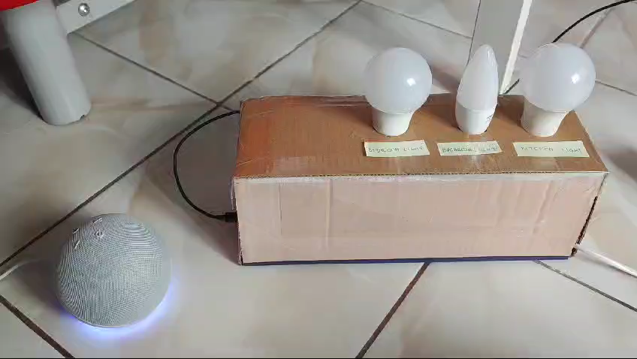
DEMO

Slide 14

Thank you!
Apopei Cristina Andreea Coman Ruxandra Maria Stanescu Denisa
FILS 1231B, Spring 2024
Please keep this slide for attribution

